Slide 1
Havirneanu Albert-Andrei
Resolution proposition
Exercise 4.3

Slide 2
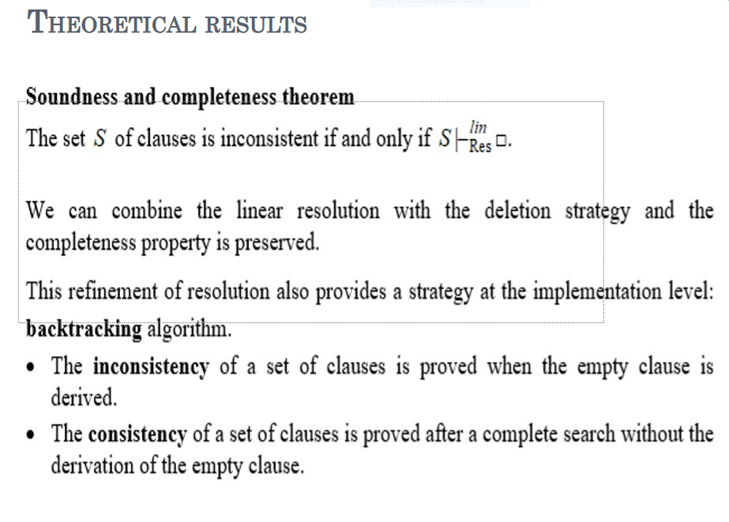

Slide 3
Problem statement
Build a linear refutation from the following set of clauses:
S3 = {q ∨ r, ¬p, ¬p ∨ r, p ∨ ¬r}

Slide 4
C1 = q ∨ r
C2 = ¬p
C3 = ¬q ∨ r
C4 = p ∨ ¬r

Slide 5
C1 = q ∨ r; C2 = ¬p; C3 = ¬q ∨ r; C4 = p ∨ ¬r
C1: top clause
C5 = Res(C1 , C3) = r
C6 = Res(C5 , C4) = p
C7 = Res(C6 , C2) = □
In conclusion, the set S is inconsistent because □ was derived from it

Slide 6
